Slide 1


Rakshati Nisarga
Smart waste collection system
Vivekanand Education Society’s Institute of Technology, Computer Department
Bhavika Motiramani
Muskan Asrani
Sanjana Ahuja
05 March 2020

Slide 2
Abstract.
Rakshati Nisarga is a smart phone based application which aims at saving the environment by providing a platform where people can connect with firms which facilitate recycling of electronic waste.
Users need to register and verify themselves so as to ensure that only legit people are able to use the system.
After that the request will be processed and a team will be dispatched to collect the waste and product and send it safely to the company.
Users can also keep a track of the status of the product.
Once the product has reached the company successfully, the user will receive a voucher from that company via the application.
05 March 2020

Slide 3
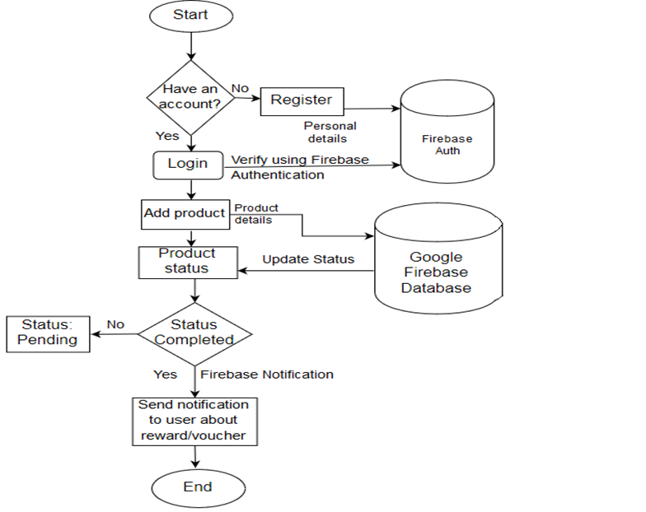
Proposed Architecture/Diagram
05 March 2020

Slide 4
Technology Stack
Front End:
oXML
oJAVA
Back End:
oJAVA
oFirebase
05 March 2020

Slide 5
Conclusion
•The environment is ours to save, not God but us.

